Slide 1

SpielPlatZ
Next Generation Playground
Bhagwan Mahavir College of Engineering & Technology

Slide 2

What is SpielPlatZ
SpielPlatz is a platform designed to help student & professional to experiment , learn & train . SpielPlatz can be used be anyone , from anywhere over the internet. SpielPlatz can be used for practicing any computer technology including high end tech ( AI or ML ) more importantly cyber security (attack & defense)

Slide 3

Abstract
The virtual environment for practising cyber security is indeed not only to the cyber security experts it will also be use full for the students , professional & the institution who are preparing the next worriers . The virtual cyber lab includes the creation of labs ,sharing of expensive hardware and tools . This lab not only focus on practical hands on practice but also on theatrical concepts and discussion This lab is based on cloud arch and available over internet using just a web browser. This lab also provide the GUI & SSH connectivity over web and the lab is compatible with any device which has a HTML 5 supported web browser and a internet connection. There are many option available but all are having one of the disadvantage some lack on interface , skills , deployment & understanding of lab setup.

Slide 4
Abstract SpielPlatZ
The virtual environment for practicing cyber security is indeed not only to the cyber security experts it will also be use full for the students , professional & the institution who are preparing the next worriers . The virtual cyber lab includes the creation of labs ,sharing of expensive hardware and tools . This lab not only focus on practical hands on practice but also on theoretical concepts and discussion .

Slide 5
Abstract Advantages SpielPlatZ
There are many option available but all are having one of the disadvantage some lack on interface , skills , deployment & understanding of lab setup . This has interface , deployment & minimal skill requirement.

Slide 6
Abstract Architecture SpielPlatZ
This lab is based on cloud arch and available over internet using just a web browser. This lab also provide the GUI & SSH connectivity over web and the lab is compatible with any device which has a HTML 5 supported web browser and a internet connection.

Slide 7
Why SpielPlatZ
Why SpielPlatZ ?
The answer is its simple , ready to use from anywhere with any devices . Not only the Accessibility is the highlighting part SpielPlatZ is also click to ready & cost effective . SpielPlatZ is the solution develop to reduce the all unnecessary task & parts that doesn't need to address so that u can work & concentrate on the core task.

Slide 8
Comparison
SpielPlatZ | Team Viewer Screen Share | RDP / VNC Native Client
Processing on server side only | Processing define by task but never perform on server | Processing on both side depending on task
Click to start ( user / pass ) | Each end needs to accept | Configure depended
Can be bound to security policy | All security allowed except internet , firewall | Can be bound to security policy
Either ends don’t know each other | Other end known to each other | Each end must be know
Uses native client with gateway for delivery | Custom protocol with third party service involvement | Native definitions
Moderately response right to other | Response depended upon processing & internet | Response depended upon processing & internet

Slide 9

Alternatives
Vendor | System Requirement | Skills Require | Cost & Popularity | Other Requirement
VMware & Virtual Box | VT-X & Hypervisor support | Virtualization & skills to run them | Some are free & some are costly | High-end Hardware &law Awareness
Back Box , Cyber Gym & Offense Security | Internet | N/A | Pay per Use | Only enterprise User & certification
Self Made Lab (Real Hrd) | VT-X & Hypervisor support | Hardware & software + Internetworking | Huge investment | All skills as System Requirement
AWS , Azure & Oracle | Internet | Cloud Skills | Pay per Use | All skills as System Requirement

Slide 10
Problems With Alternatives
System Requirement | Skills Require | Cost & Popularity | Other Requirement
VT-X & Hypervisor support | Virtualization & skills to run them Hardware & software + Internetworking | Some are free & some are costly Hardware maybe a Huge investment | High-end Hardware & cyber law Awareness & All skills as System Requirement
Cloud & internet | Cloud Skills | Pay per Use | Must know cloud Domain & All skills as System Requirement

Slide 11
Name: Rahul Rathi
Skills : Java ,Virtualization & Internetworking
Roll : Backend & Processing Unit
Enroll : 140060107046
Name: Divya Limbani
Enroll : 120010131005
Roll : Frontend
Skills : HTML , CSS, Bootstrap, C .
Name: Rahul Rathi
Enroll : 140060107046
Roll : Backend & Processing Unit
Skills : Java ,Virtualization & Internetworking
Name: Bhavika Patel
Enroll : 140060107007
Roll : Processing Unit & Database management
Skills : Java , HTML , Database .
TEAM INTRODUCTION

Slide 12

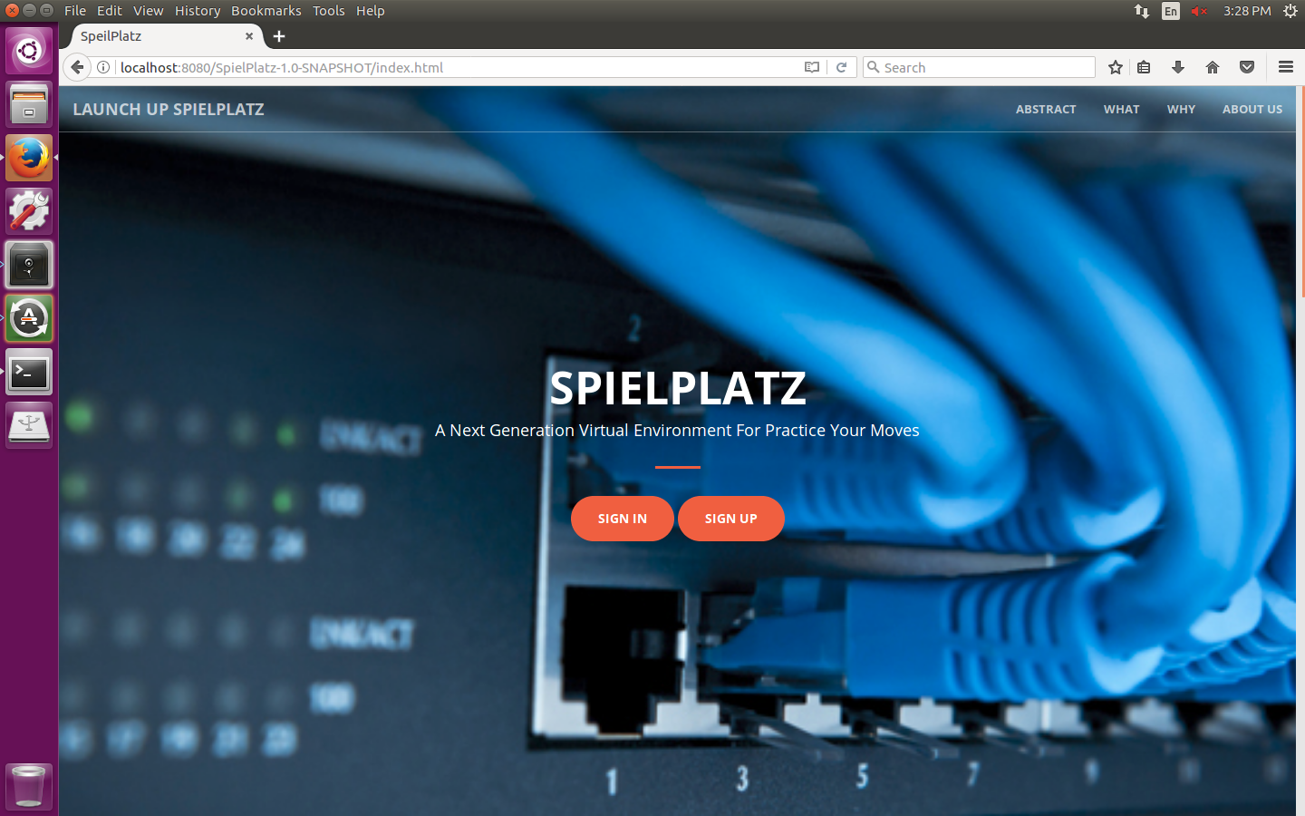
SpielPlatZ | Solution

Slide 13
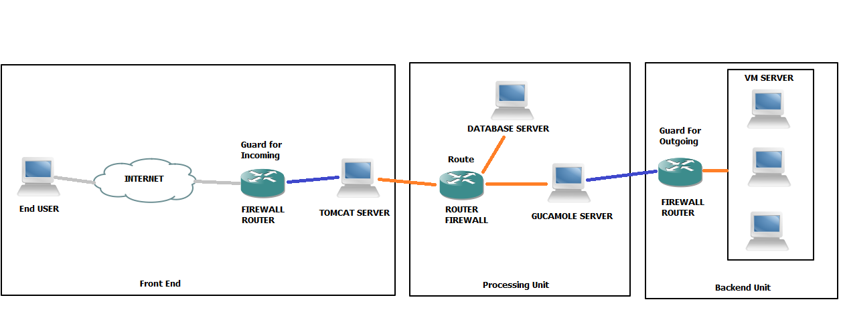
SpielPlatZ | Overall View

Slide 14
SpielPlatZ | Front End
USER
WEB BROWSER
HTTP REQUEST
TOMCAT SERVER
BOOTSTRAP
SERVLET
GUCAMOLE SERVER
CONNECT
HTTP RESPONSE
JSP
DISPLAY
ACTION

Slide 15

SpielPlatZ | Processing Unit
Tomcat Server
HTTP REQUEST
HTTP RESPONSE
JAVA SERVLET
GUCAMOLE
DATABASE
VM MANAGER
VM CLUSTER
BOOTSTRAP
JSP
STARTUP
MANAGEMENT
SHUTDOWN

Slide 16
SpielPlatZ | Backend
VM MANAGER
CONNECT
DATABASE
USEER / PASS
VM RDP
RDP
VM CLUSTER
STARTUP
MANAGEMENT
SHUTDOWN
DISPLAY
ACTION

Slide 17

Algorithm
User
WEB BROWSER
HTTP REQUEST
TOMCAT SERVER
GUCAMOLE & DATABSE SERVER
GET USER CONFIG
VM MANGER
VM SELECT & STARTUP
RDP RESPONSE TO GUCAMOLE SERVER
HTML RESPONSE

Slide 18
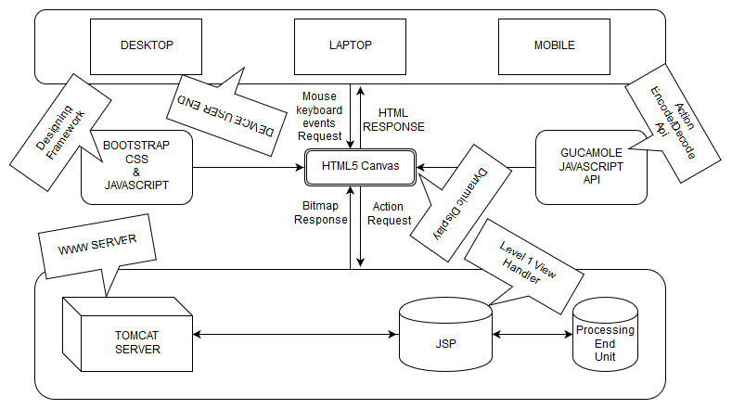
SpielPlatZ | Architecture

Slide 19
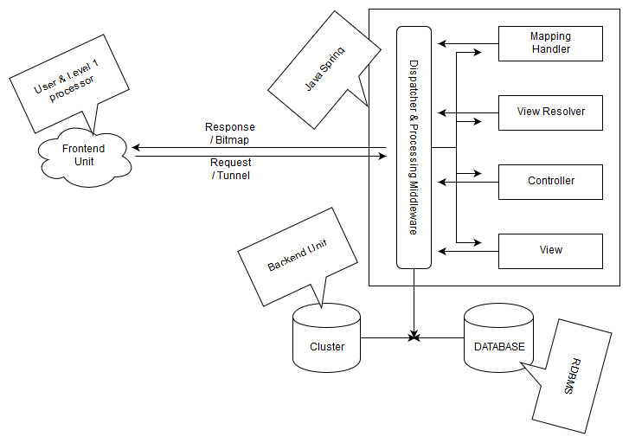
SpielPlatZ | Architecture

Slide 20
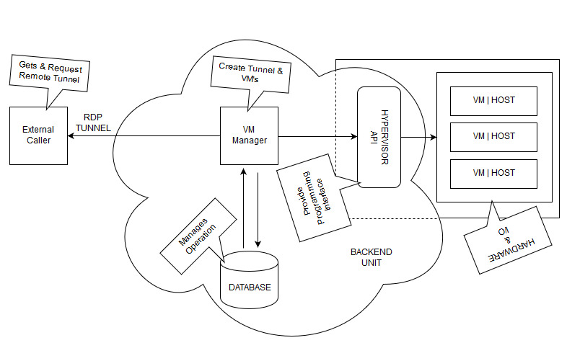
SpielPlatZ | Architecture

Slide 21
Advantages
Modular
Cloud Model
Easy to Get started
Environment Friendly
Full Os just Using Browser
Make & Load Topology in Secure Environments
Take Your lab where you go

Slide 22
Disadvantages
Internet & Web Browser Require
Security Policy
New evolving Technology
Limited Options *
Only software training & complexity possible

Slide 23

Thank You

